Slide 1
Fundus Vessel Segmentation: Enhancing U-Net with Transformer in the Bottleneck
Reporter：WangZifan
Research Team: Hao Shilong, Dong YiZhi, WangZiFan, Dong WenYu, Zhang TongYu
Research Field: Medical Image Segmentation · Deep Learning · Computer-Aided Diagnosis

Slide 2
01
Research Background and Problems
02
Solution and Model Comparison
03
Expected Performance and Core Advantages
04
Experimental Design and Validation
05
Research Significance and Conclusion
06
Acknowledgments and References

Slide 3
Research Background and Problems
PART 01

Slide 4
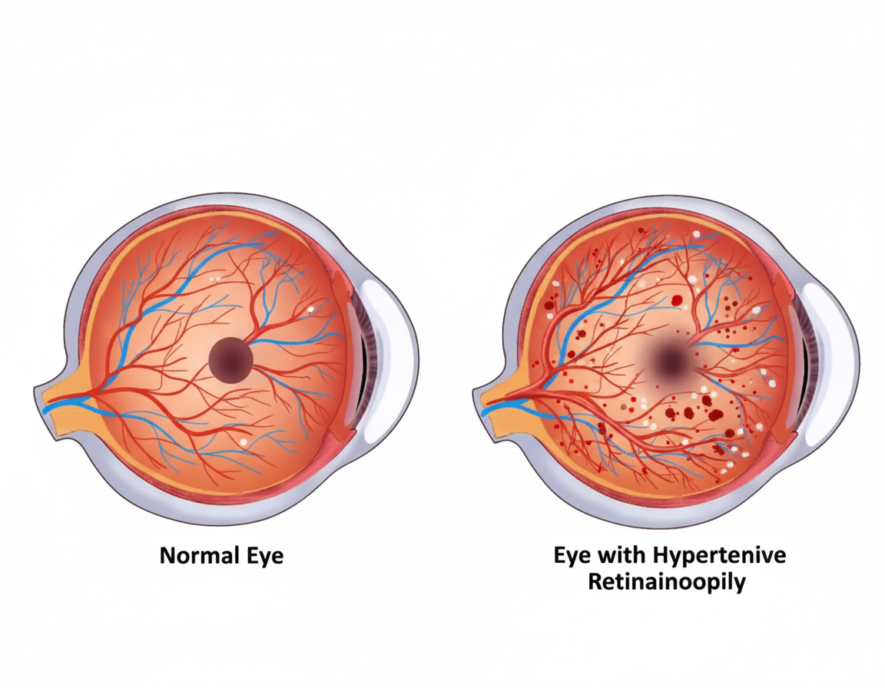
PART 01
Clinical Importance:
Fundus vessel segmentation is crucial for the early screening of ocular diseases such as diabetic retinopathy and glaucoma.
Technical Bottleneck:
U-Net and its variants struggle to model the long-range dependencies inherent in tree-like vessel structures.
Current Issues:
Limited receptive field of convolutional operations.
Easy loss of spatial correlation between small vessel branches and main trunks.
Leads to discontinuous segmentation and increased breakpoints in small vessels.

Slide 5
Solution and Model Comparison
PART 02

Slide 6
PART 02
Core Hypothesis
Innovative Model: U-Net-Transformer
Model Comparison
Integrating a Transformer into the bottleneck layer of U-Net can significantly improve the modeling of long-range dependencies.
Retains the local feature extraction capability of CNNs.
Introduces the global attention mechanism of the Transformer at the bottleneck layer.
Achieves a balance between computational efficiency and performance.
U-Net: Classic structure, strong in capturing local features.
U-Net++: Enhances feature fusion through nested skip connections.
U-Net-Transformer: Integrates a Transformer module in the bottleneck layer, combining global and local features.

Slide 7
Expected Performance and Core Advantages
PART 03

Slide 8
PART 03
01
02
03
Expected Performance Comparison (Quantitative Metrics):
Expected Visualization Results:
Three Core Advantages
Dice Coefficient, IoU, AUC (small vessels): U-Net-Transformer is expected to outperform U-Net by 5-8% and surpass U-Net++.
Sensitivity/Recall: Significant improvement, with enhanced detection capability for small vessels.
Computational Complexity: Only a slight, manageable increase.
U-Net-Transformer demonstrates superior performance in small vessel connectivity and completeness.
Precise Problem Targeting: Introduces the Transformer at the most abstract feature level—the bottleneck layer.
Lightweight and Efficient Enhancement: Minimizes computational cost while retaining the advantages of CNNs.
Outstanding Performance Improvement: Expected 5-8% AUC improvement for small vessel segmentation.

Slide 9
Experimental Design and Validation
PART 04

Slide 10
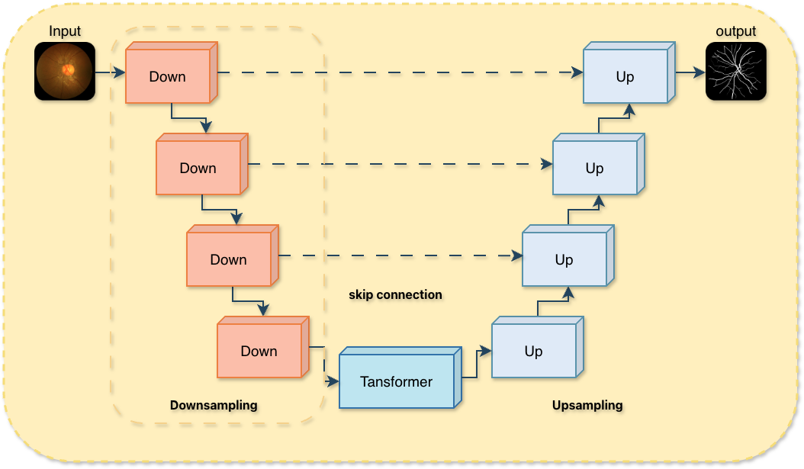
PART 04
Optimizer: AdamW
Loss Function: Dice + BCE combined loss
Data Augmentation: Rotation, flipping
Dataset
Training
Setup
Evaluation
Metrics
DSC, IoU, AUC, F1-score, Sensitivity, Specificity.
DRIVE (40 fundus images).

Slide 11
Research Significance and Conclusion
PART 05

Slide 12

PART 05
Clinical Significance:
More accurate vessel segmentation facilitates earlier disease diagnosis.
Methodological Contribution
Provides a lightweight modification paradigm for CNN-Transformer hybrid architectures.
Scalability
Transferable to other tree-like structure segmentation tasks (e.g., nerve fibers, pulmonary bronchi).
Conclusion:
U-Net-Transformer addresses the long-range dependency modeling problem with minimal computational cost and is expected to comprehensively surpass U-Net and U-Net++ on the DRIVE dataset.

Slide 13
Thank you for your attention!
Part 6: Acknowledgments and References
References：Ronneberger et al. (U-Net), Zhou et al. (U-Net++), Dosovitskiy et al. (ViT), etc.

